Slide 1


VIDYAVARDHAKA COLLEGE OF ENGINEERING
Autonomous Institute affiliated to VTU, Belagavi and approved by AICTE, New Delhi
Presented by,
Chinmaya B N
Karthik R
Vamshi Gangamma H G
Varsha Gowramma H G

Slide 2
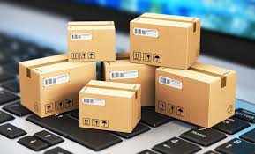

E-commerce and Food delivery Waste Recycling and Reward System.

Slide 3
Introduction
E-commerce packaging waste refers to the vast amounts of materials used to protect and deliver products to our doorsteps.
From cardboard boxes and plastic packaging to bubble wrap and Styrofoam, the sheer volume of waste generated is staggering.
Effects include resource depletion , greenhouse gas emission and eco system disruption.
Ref: https://www.seamovement.org/

Slide 4
Consumers must gather all e-commerce waste after unpacking the online products.
Ensure to collect cardboard boxes ,plastic packing and other shipping materials.
Consolidate the collected e-commerce waste for proper disposal or recycling.
Step 1

Slide 5

Step 2
Visit the nearby e-commerce waste dumping facility (hub)
After unpacking their e-commerce products, consumers should consider visiting the nearest e-commerce waste dumping facility.
Establishing dedicated recycling units strategically located in accessible areas, equipped with advanced sorting mechanisms.
By visiting such facilities, consumers can ensure that the e-commerce waste is disposed of properly and in an environmentally friendly manner.

Slide 6

Step 3
Enter the User Id and Password in the Visible screen
The consumers have to enter their User Id and Password accurately on the website's login page.
After entering , the consumers Credentials will be authenticated.
This grants access to their account and enables them to view the personalized information.
.

Slide 7

Step 4
Dump the waste into conveyer belt
An AI model is employed to scan and identify the type of ecommerce waste being submitted, ensuring that only valid waste is accepted for recycling.
The weight of the accepted e-commerce waste is measured, recorded, and transmitted to the user interface for further processing.

Slide 8
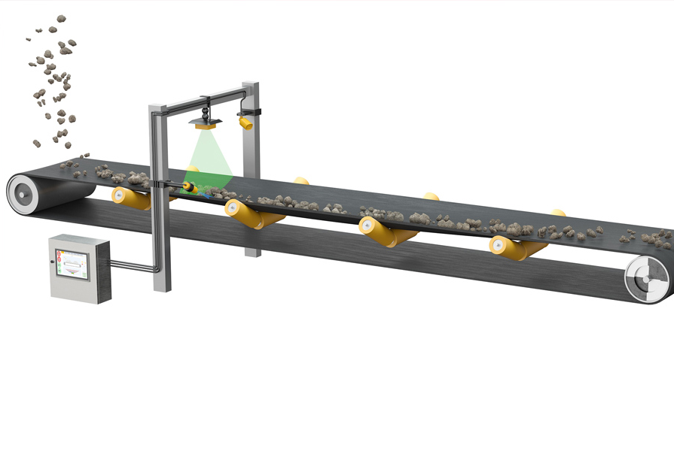
Step 5
Weight is fetched by the UI
The weight of the accepted e-commerce waste is measured, recorded, and transmitted to the user interface for further processing.

Slide 9

Step 6
The coins is displayed on the screen and is updated in application
The user interface calculates the value of the submitted ecommerce waste based on its weight and converts it into alpha coins.
The consumer has the choice to accept or decline the conversion and credit.

Slide 10








Step 7
Redeem the coins to get exiting offers from different websites

Slide 11

Step 8
The team, responsible for managing the recycling program, collects the accumulated e-commerce waste from the recycling hubs regularly.
They explore collaboration opportunities with e-commerce companies for proper recycling or reuse of the collected waste.

Slide 12
User Interface Model
Link for UI
https://k-arthik-r.github.io/Alpha/
The Current UI Sample is Built Using React Js and validations are done using JavaScript.
Link for Reward System
https://k-arthik-r.github.io/Alphashop/

Slide 13
Advantages
Environmental Sustainability | Incentivized Recycling | Convenient Accessibility
User-Friendly Interface | AI Verification | Secure process

Slide 14
E-commerce Companies
Recycling Facilities
AI Experts
Financial Institutions
Collaboration needed

Slide 15

Conclusion
The E-commerce Waste Recycling and Reward System incentivizes consumers to recycle e-commerce waste through alpha coins. With user-friendly interfaces and AI verification, it promotes convenience and efficiency. Collaboration with e-commerce companies, recycling facilities, AI experts, and financial institutions is vital for its success. Together, we can drive sustainable waste management practices and reduce environmental impact.

Slide 16


THANK YOU

